Slide 1
Soar 9.6.0’s Instance-Based Model of Semantic Memory

Slide 2
Representation Basics
Identifiers and Objects

Slide 3
Identifiers and Objects
Each memory system is composed of features grouped into objects
Features
Represented using two symbols, one for the feature label and one for its value
Objects
Multiple features can be grouped into abstract “objects” by assigning them all the same object label
Soar identifiers are these object labels
Linking Objects
A link is a feature that connects two objects by having a soar identifier in the value element
(except for procedural memory)
feature = attribute + value
e.g. ^color green
^size 6
^name Bob
^part-of-speech verb
object = feature1 + … featuren
e.g.: ^type wood
^color blue
^shape cube
label = identifier
e.g. B1
link = attribute + identifier
e.g. B1 ^on-top B2

Slide 4
How is memory in Soar represented and organized?
Working Memory Elements (WME)
A labeled feature, i.e. a symbol triple
So, objects are composed of one or more working memory elements
Links make our memory representation a directed graph
Each soar identifier represents a single node in the memory graph
WME = label + feature
WME = identifier + link
WME = identifier + attribute + value
WME = identifier + attribute + identifier
e.g. B1 name block1
e.g. B1 on-top B2
object = WME1 … WMEn
Insert Image Here

Slide 5
Soar’s Representation of Memory
Working memory, semantic memory and episodic memory each have their own memory graphs
So, we have a different type of identifier for each memory system…
Insert Image Here
Insert Image Here

Slide 6
Soar’s Representation of Memory
Three types of identifiers in Soar:
Short-term identifiers (STIs): S1
Appear in working memory only
Long-term identifiers (LTIs): @L1
Created when knowledge from working memory is added to semantic memory
Appears in working memory, semantic memory and episodic memory
Episodic memory identifiers
Not important in this discussion
Never appear in working memory or semantic memory
Soar identifiers can be considered an anonymous grouping mechanism
Labels are arbitrary, transient, assigned at runtime
Has been described as syntactic sugar [Rosenbloom and Laird]

Slide 7
Main Question

Slide 8
Cross-Grounding Problem?
How do two memory systems, each with their own anonymous naming mechanism, maintain accurate references from structures within one system to corresponding structures in the other?
Note: This also applies to procedural and episodic memory:
How should agent rules incorporate knowledge retrieved from semantic memory?
How can episodic memory retain how semantic memories changed over the agent’s experience?

Slide 9
How do memory systems interact?
Lots of possibilities:
Shared memory or whiteboard system
Are objects copied from one system to another and then “shared”?
Changes made to one object will mirror the same changes in the other memory system?
Instance-based
Do they copy objects from each other which then become independent?
Something in between?
Do they “check out” objects, modify them, then check them back in?
Can we allow identifiers in one system appear in another system?
etc.

Slide 10
Soar’s Answer?

Slide 11
“Something in between”
STIs become “promoted” to LTIs when stored to semantic memory (or manually added)
Sub-structure is independent
Modifying the sub-structure “below” an LTI’s in WM does not affect its sub-structure in semantic memory
So, the features of the object in WM may differ from the one in semantic memory, despite sharing the same LTI
1-to-1 mapping from a node in short-term memory to a node in long-term semantic memory
LTIs are the only identifiers that can exist in all four memory systems

Slide 12
“Something in between”
LTIs are treated like short-term identifiers in most cases
They group features into objects
Rules can match LTIs just like normal identifiers
Rules can even create structures that directly specify LTIs
but…

Slide 13
“Something in between”
LTIs are also treated like constants in some cases
Soar assumes a given LTI always refers to the same object in semantic memory, even across different runs
Note: Not architectural. User must manually ensure this is true!
Why?
To act as a name or label, which eliminates cross-grounding problem
Allows agent to directly refer to structures in semantic memory for future retrievals or updates
Allows learned rules to reference specific semantic memories

Slide 14
Why is this a Problem?

Slide 15
Original Motivation
Made many use cases difficult or impossible. Some examples:
Episodic memory accurately showing what an LTIs structure looked like at different times
Reasoning that required manipulating and composing different structures that involved LTIs
A change one place may inadvertently change something somewhere else
Reasoning that required using the same LTI in different places
Same word appearing multiple times in a sentence
Different word senses

Slide 16
Unexpected Interactions When Learning Rules
Unexpected interactions can occur when learning rules because there is an SMem link on every level
This means two recalls at different times can independently create the same LTI in two different states
Each SMem link can act like an LTI spawn point
Structures connected to the two recalls may now interact even though may not have necessarily been meant to.

Slide 17
Unexpected Interactions When Learning Rules
This is in sharp contrast to short-term identifiers
They can’t “move” from one state to another except through rules that test features in one state and create them in another.
This is a key aspect of PSCM that LTIs violate
Chunking needs those types rules to understand how knowledge in one state is dependent on knowledge in another.

Slide 18
Unexpected Interactions When Learning Rules
Makes it harder to determine what knowledge in the superstate was needed by the substate
Makes it harder to determine what is a result, i.e. when a rule should be learned
Often required the rule to be “repaired”
Weird implication:
What happens prior to the learning episode may affect the content of the rule and whether a rule is learned at all

Slide 19
Architectural Complexity
Maintaining LTI’s unusual hybrid nature required a lot of special-purpose code that led to complexity and bugs
A constant can now appear in the identifier element of conditions/actions
Soar identifiers can now appear in rules
No longer an anonymous naming mechanism
No longer a run-time assignment
The “level” of Soar data structures are harder to determine
Identifiers are no longer all created at run-time
Identifiers can “appear” in multiple states because of different recalls

Slide 20
New Model

Slide 21
Instance-Based Interactions Between Memory Systems
Every new recall from SMem or EpMem:
Produces an entirely new structures in WM
Each structure is considered an instance
Each instance uses entirely different short term identifiers
EpMem pretty much already worked that way, except it would use the actual LTIs when it recreated a structure that once used an LTI
No shared memory, mirroring or “automatic merging”

Slide 22
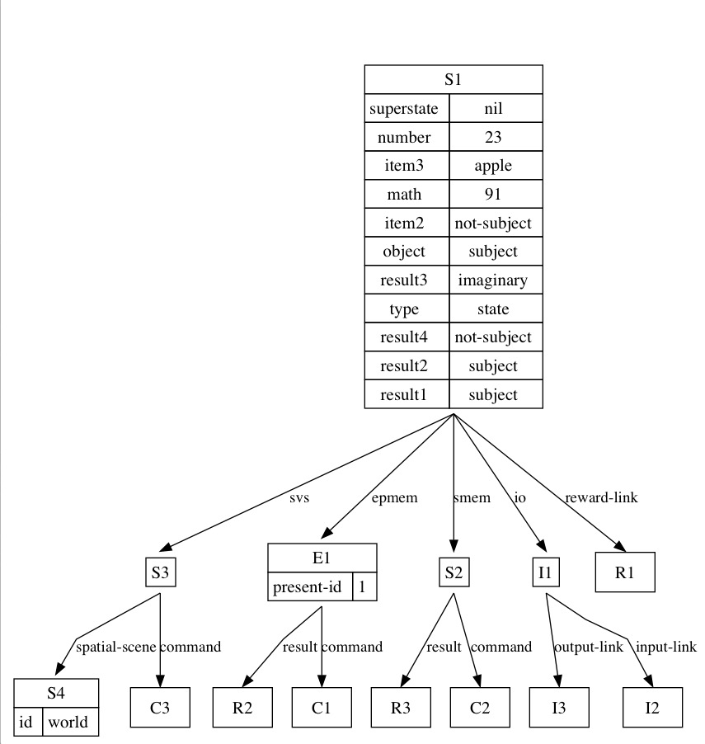
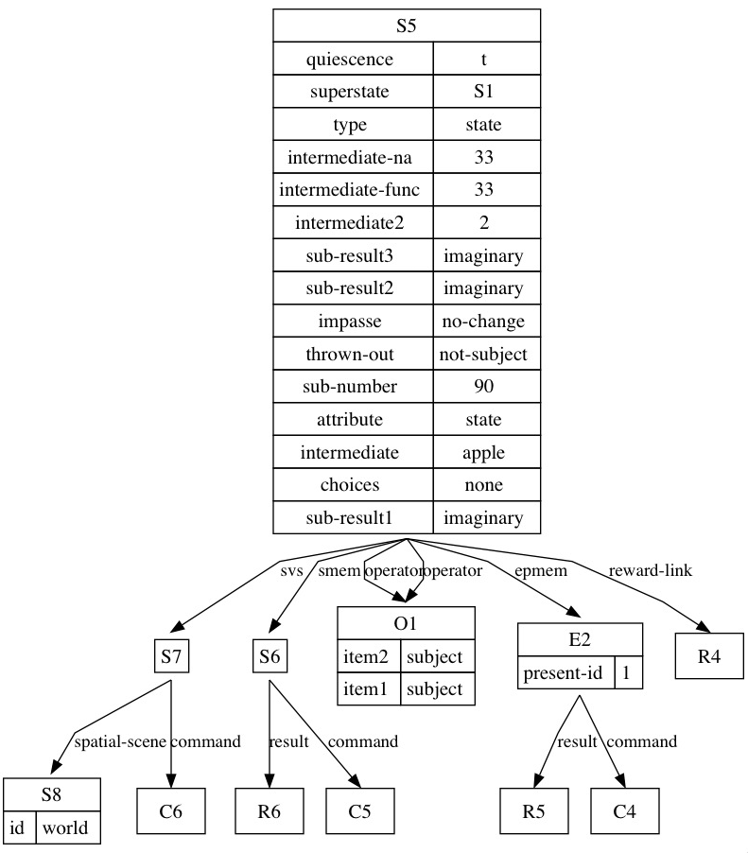
Many-To-One Connections to Semantic Memory
Soar now architecturally maintains links from an arbitrary number of STIs and episodic IDs to the LTI from which they were created
LTIs are no longer a 1-to-1 connection between nodes in two memory systems
Working Memory
Semantic Memory

Slide 23
Many-To-One Connections to Semantic Memory
Soar creates these links every time:
A memory is recalled from semantic memory
An episode is reconstructed from episodic memory
A chunks fires that was based on knowledge retrieved from semantic memory
So, Soar does the housekeeping that eliminates cross-grounding problem

Slide 24
Basic Usage

Slide 25
New Long-Term Identifier Format
Working Memory:
Letter + Number, for e.g “S1”
Semantic Memory:
@ + Number , for e.g “ @23”
Important notes:
LTIs never appear in any other memory systems
Whenever Soar prints to the screen any STI that are linked to LTIs, it will print the linked LTI in parentheses
e.g.: (S1 ^my-linked-sti L1 (@23)) as opposed to (S1 ^my-linked-sti @L1)

Slide 26

Command-Line Interaction
Most commands work exactly like they did before.
Simply need to use the new @some-number notation:
Two things that have indeed changed:
‘smem –visualize’ has been removed
Replaced with all new code in the visualize command
‘smem –print’ has been removed
Soar’s long-term memories are now considered so intimate that they are private.

Slide 27
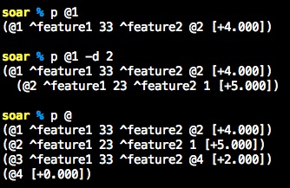
Printing Long-Term Semantic Memories
Since STIs and LTIs no longer share namespaces, we can simply use the print command to print them:
Note: To print all of semantic memory, just leave the number out, i.e. “p @”

Slide 28
Storage

Slide 29
What You Need To Remember
Agent must now be more deliberate about:
Storage: Whether it’s storing a new object or updating an existing object in semantic memory
Recall: How it will combine knowledge from multiple semantic memory recalls
Things aren’t automatically “merged” into a single identifier

Slide 30
What You Need To Remember
Agent must now be more deliberate about:
Storage: Whether it’s storing a new object or updating an existing object in semantic memory
Recall: How it will combine knowledge from multiple semantic memory recalls
Things aren’t automatically “merged” into a single identifier

Slide 31
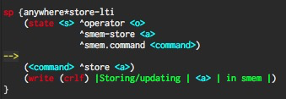
Semantic Memory Now Has 2 ‘store’ Commands
store
More accurate name: “update if you can, store if you need to”
If an STI being stored is linked to an LTI:
Soar will updated the SMem object the STI points to
If an STI is not linked to an LTI:
Soar will create a new LTI in SMem and link the STI to it

Slide 32
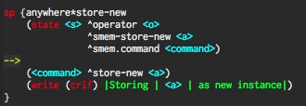
Semantic Memory Now Has 2 ‘store’ Commands
store-new
Ignores any LTI links in submitted WM structure
Always creates an entirely new structure in LTM

Slide 33
What happens when you use ‘store-new’ with STIs that already have LTI links?
Do the STIs get re-linked to the new SMem objects?
Or do they retain their original links?
Answer: Soar will NOT re-link STI to the newly-created LTI but will link other STIs
Any STI with a link will still point to the original long-term memory they were linked to before the store-new
Any STIs that don’t have links will get linked to the newly created long-term memory

Slide 34
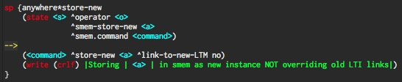
New Parameter: ^link-to-new-LTM
If this behavior is not desired, agent can add a ^link-to-new-LTM yes augmentation to override this behavior
This option was added because an agent may need to retain the preferences and backtrace history that created the WMEs being stored in semantic memory.
A newly retrieved instance would not have the same backtrace history.
So, this feature is to help facilitate learning of future rules based on the stored working memory element.

Slide 35
Semantic Memory Recall

Slide 36
What You Need To Remember
Agent must now be more deliberate about:
Storage: Whether it’s storing a new object or updating an existing object in semantic memory
Recall: How it will combine knowledge from multiple semantic memory recalls
Things aren’t automatically “merged” into a single identifier
So, how do we give an agent the ability to do something similar?

Slide 37
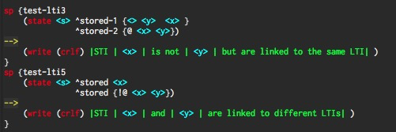
Testing Whether Two STI Links are Equivalent
Soar 9.6.0 introduces the new “@” and “!@” tests
‘@’ passes when two STIs are linked to the same LTI
‘!@’ passes when two STIs are not linked to the same LTI
Example:

Slide 38
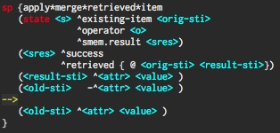
Using @ Test to Merge Two Recalls

Slide 39
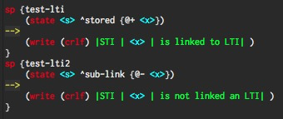
Two New Experimental Tests
@+, @-
Tests pass depending on whether STI has link to an LTI at all
Not sure if these will be useful

Slide 40
What to Remember
Every working memory stucture that is created by a semantic memory recall:
is completely independent from working memory stuctures created by other recalls
contains links to the corresponding long-term identifiers from which they were based on

Slide 41
What to Remember
Agent can access those links via new LTI condition tests
The main test to remember is ‘@’ which passes if two STIs are linked to the same LTI
New LTI condition tests are used for two things:
To denote a specific long-term memory to retrieve or update
Comparing two STIs to see if they are instances of the same long-term memory
Often used to combine knowledge from multiple recalls

Slide 42
Interactions with Other Memory Systems

Slide 43
Interactions with Other Memory Systems
Episodic Memory
Creates a new semantic memory instances that reflects structure at the time the episode was recorded
Reconstructed episode will contain invisible links to semantic memory that can be tested by rules
Currently working on allowing users to specify that query must satisfy same LTI links

Slide 44
Interactions with Other Memory Systems
Procedural memory
Actions of learned rules can create new semantic memory instances
Uses ‘LINK-TO-LTM’ RHS functions
For each LTI, EBC add a special RHS action to create its semantic memory links
LINK-TO-LTM links a newly-created STIs to a specific LTI
for e.g. (LINK-TO-LTM <new-var> 23)
Creation of these RHS actions is a chunking option and is off by default
See the ‘chunk’ command for more information

Slide 45
Nuggets and Coal
Nuggets
We can represent everything
No more problems
Was easy to convert agents
Coal
Databases not compatible

Slide 46
Secret Hack Feature #1
(<s> ^foo {@ 23 <x>}) You can test for specific LTIs. Soar has been secretly instructed to blindly treat integers as LTIs in @ and !@ tests.
In the above example, the value element would only match if it were an STI that is linked to the LTI with ID 23, i.e. @23.

Slide 47
Secret Hack Feature #2
LTI link IDs can be acquired on the RHS with the following dark magic @ rhs function:
sp blah {
(state <s> ^foo <x>) --> (<s> ^my-lti (@ <x>))}
If <x> matched an STI that linked to @23 and <s> matched the top-state, this would create the WME:
(S1 ^my-lti 23)
Only bad people would use this feature, especially in conjunction with the last feature.

